Slide 1

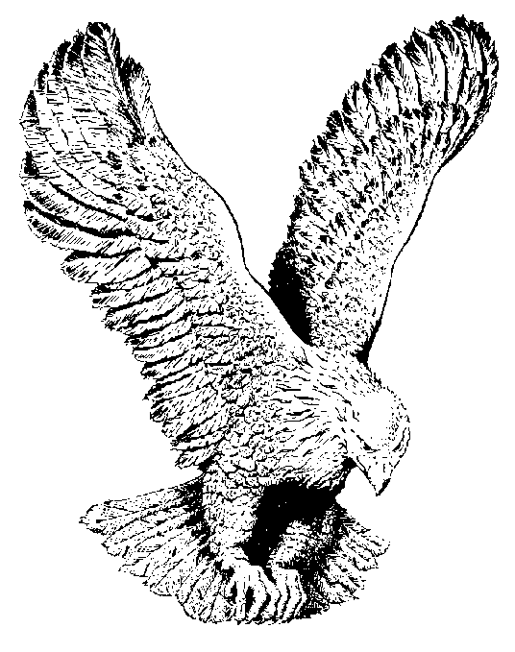
844 FAITH TURNS THE NIGHT
Faith turns the night into the day
Love drives the doubts and fears away;
And my heart is singing,
With the joybells ringing.
List to the pealing of its chimes;
Faith wins the victory every time.
Hallelujah; What a Saviour;
And just to know that He is mine.

